Slide 1
Rhythmic Music Streaming Webapp
21B06 Sachin Bairi-06 Drishti Bhatia-07 Om Navge-38

Slide 2
Introduction
Rhythmic is a music streaming web application. The main objective of the application is to manage and display the details of the songs and their metadata like the artist, album, genre, lyrics. The project is built using open APIs provided by Spotify that are available to users.
The primary purpose of the project is to search and stream music as well as view the lyrics of the songs being played and also display the top trending songs of the day. The user can also view playlists and libraries.
It is a fully functional web app with over 5000 songs.
The application is secured using Authentication Tokens.

Slide 3
Problem Statement
Due to the fierce competition between music player applications, many developers tried to add many features, advertisements and content to their respective music player in order to retain their users and attract new users.
This trend has made it harder for users to get content from their music player, which also means it's harder to filter the content that they want.
Users tend to feel frustrated and angry if they take a long time to get a reply from the application, also some applications tend to have multiple advertisements frequently. Due to this, users don’t tend to return to the same application, and 48% of users will simply uninstall or stop using the application.

Slide 4
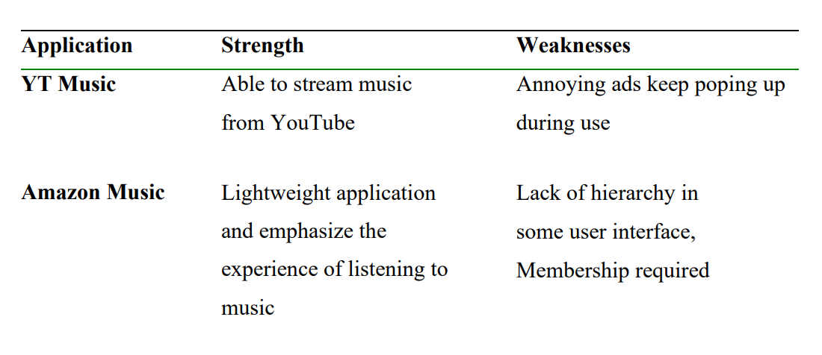
Literature Survey

Slide 5
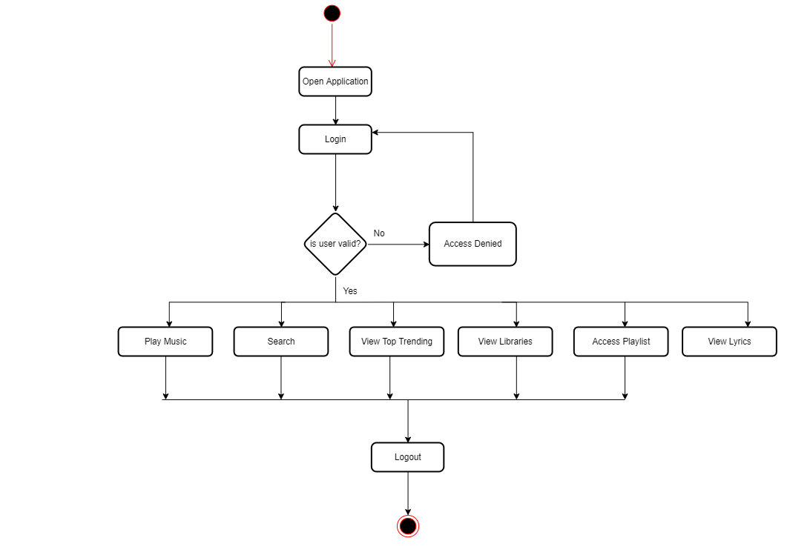
Methodology

Slide 6
Results

Slide 7
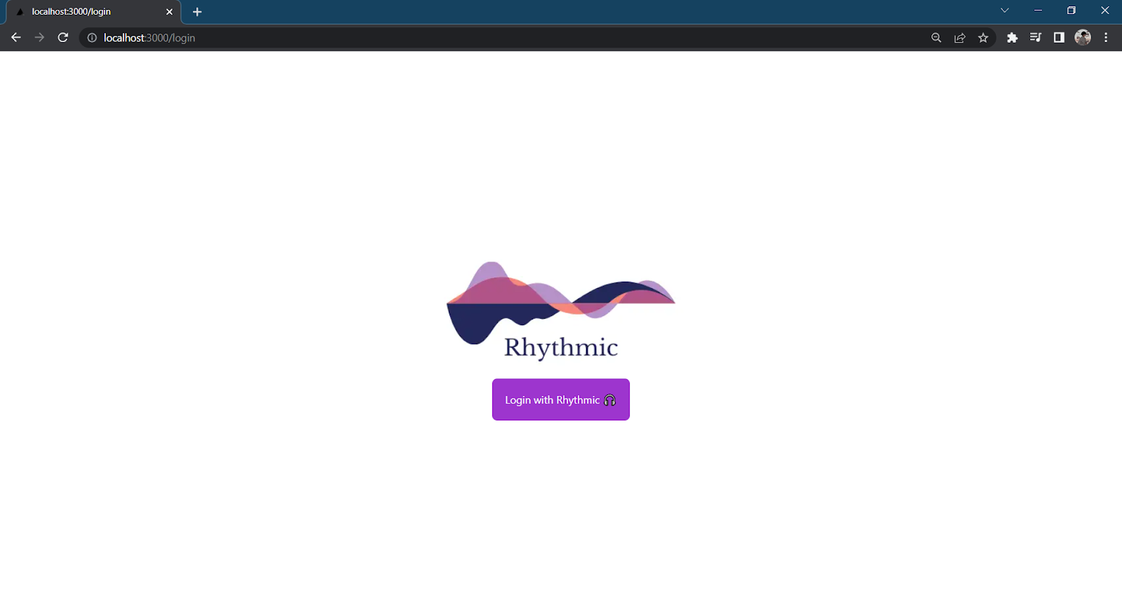
Login

Slide 8
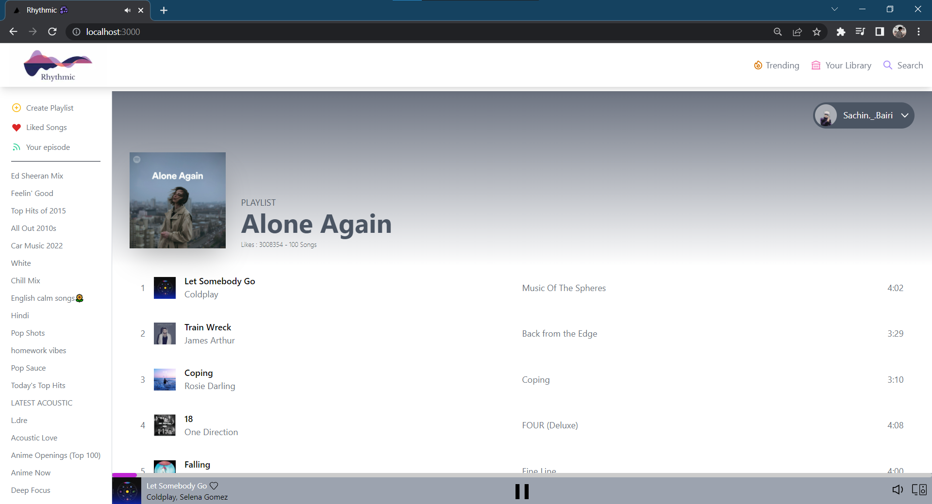
Home

Slide 9
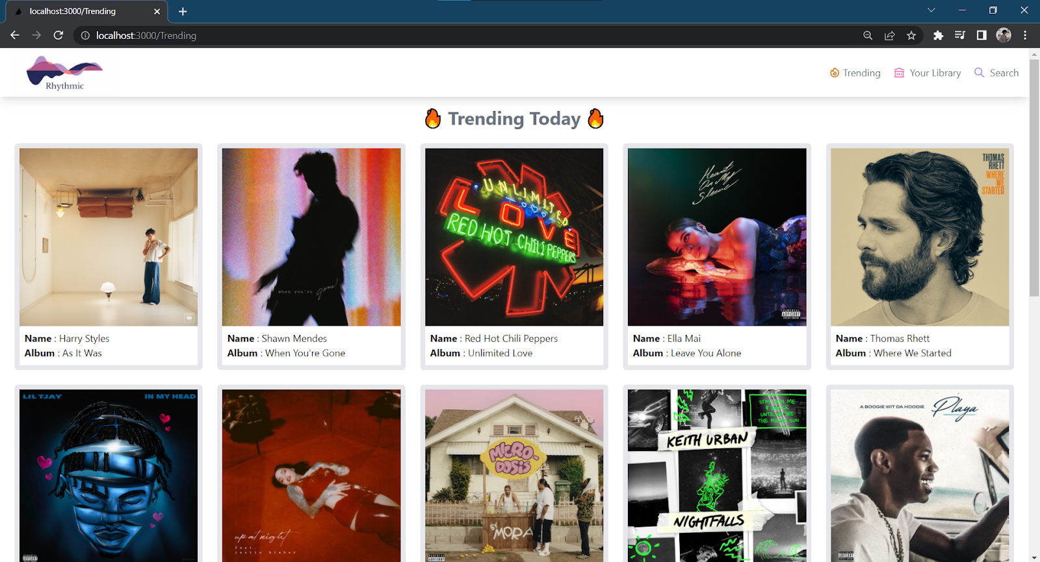
Top Trending

Slide 10
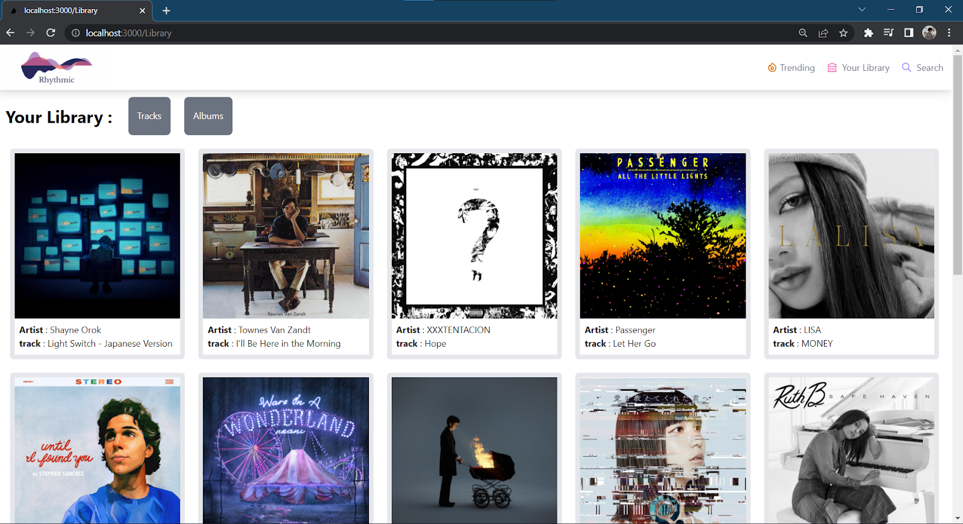
Your Library

Slide 11
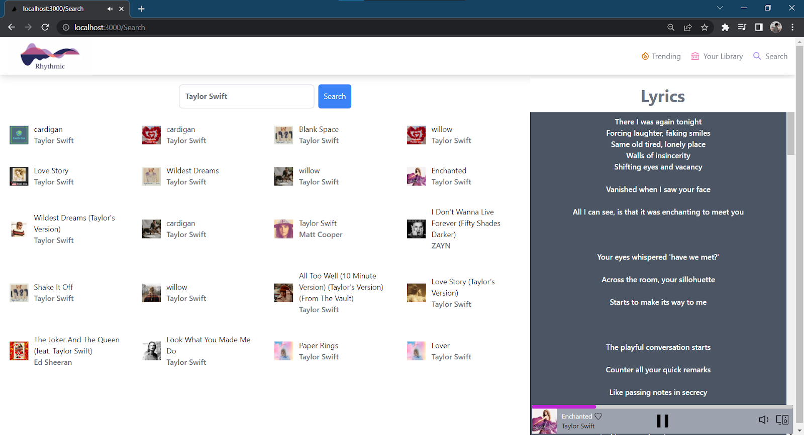
Search & Lyrics

Slide 12
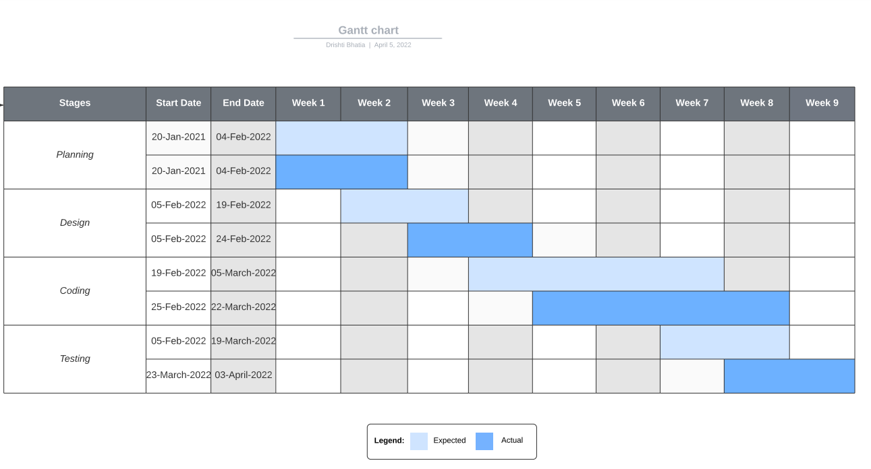
Gantt Chart

Slide 13
Thank You! Any Questions? You can find us at: rhythmic.feedback@gmail.com

